Slide 1
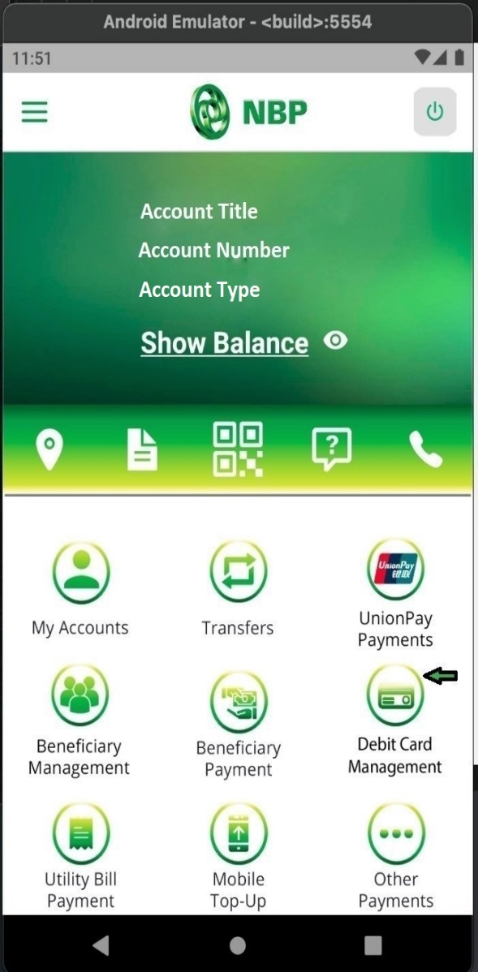
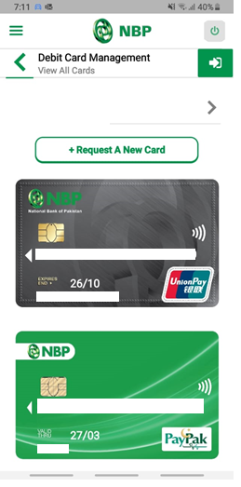
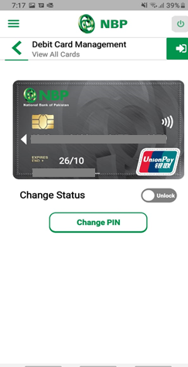
How to Change Debit Card PIN?
Tap on “Debit Card Management”
Step-1
Tap on Card to Change your Card PIN
Tap on Change PIN button
Step-2
Step-3

Slide 2
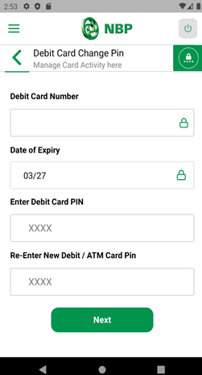
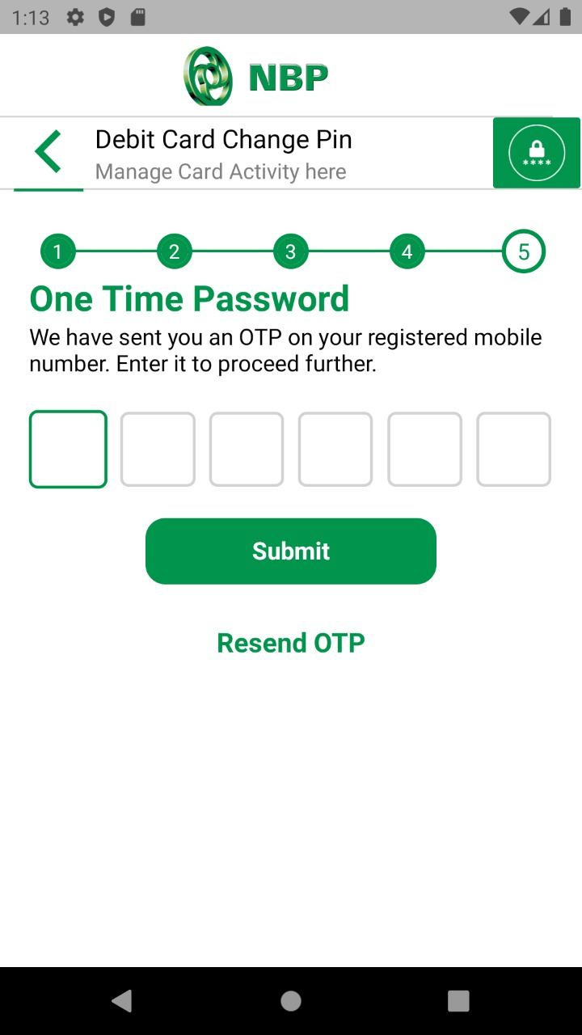
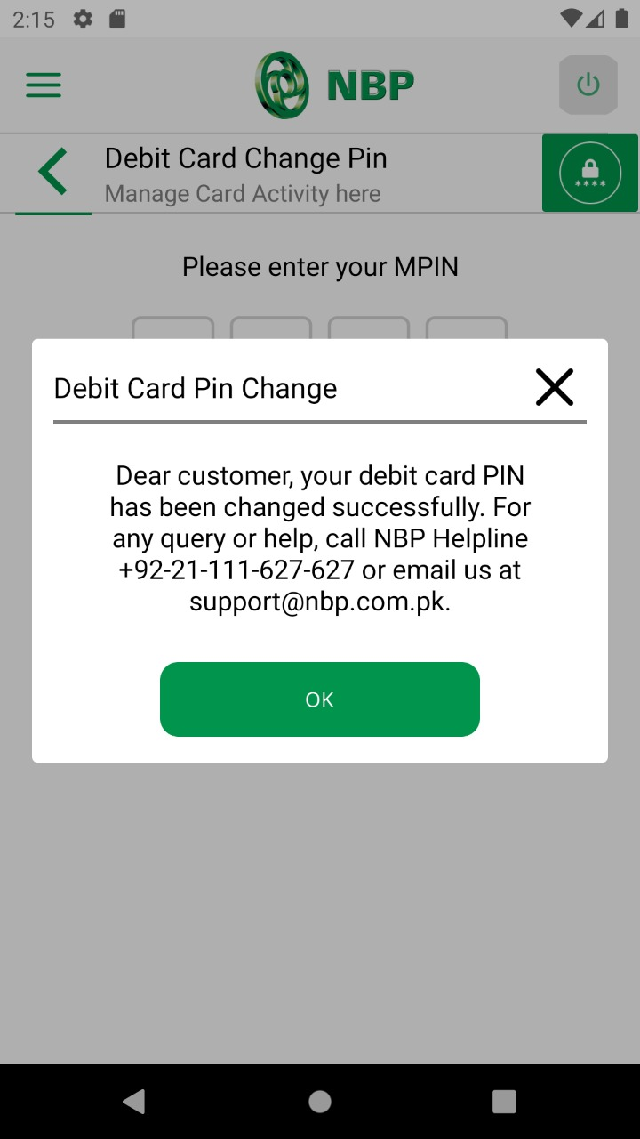
Create Debit Card PIN
Enter OTP & Tap on Submit button.
Successful Change Card PIN notification will appear on screen.
Step-4
Step-5
Step-6

